Slide 1


MINDFUL on AI Powered Mental Health Support Platform for Students
Guided By: Presented By:
Prof.Shahida Khan Nandani Chourasiya (0827IT231090)
Piyush Ghoshi (0827IT231098) Sayed Ozair Mehmood (0827IT231122)
Yash Jhanwar (0827IT231149)

Slide 2
Contents
Introduction
1.1 Overview
1.2 Purpose
Literature Review
Problem Statement
Proposed Solution
Objectives
Theoretical Analysis
6.1 Architecture
6.2 Hardware Requirements
6.3 Software Requirements
Applications
REFERENCES

Slide 3
1. Introduction
1.1 Overview
MINDFUL is an AI-powered mental health support platform designed specifically for students, providing 24/7 chatbot support and mood tracking.
Provides AI-based emotion detection and counselor recommendations for early intervention.
Includes crisis detection and escalation, online appointment scheduling, wellness reporting, and a community support forum.
Leverages NLP models such as BERT and RoBERTa to identify emotional distress and offer personalized assistance, with a gamification and reward system to boost engagement.
1.2 Purpose
Provide accessible, round-the-clock mental health support to students.
Detect emotional distress at an early stage and offer personalized wellness recommendations.
Connect students with professional counselors and reduce the stigma surrounding mental health.
Enable timely intervention during crisis situations and promote continuous emotional well-being.

Slide 4
2. Literature Review
Sr. No. | Name of Solution/System | Features | Limitations/ Drawbacks
1. | Traditional Counseling Systems | Personalized, in-depth professional guidance with trained counselors | Limited availability; long waiting times; high cost; lack of 24/7 access
2. | Mood Tracking Applications | Simple self-monitoring of mood and habits over time | No AI-based analysis; lacks intervention or counselor connection
3. | Rule-Based Mental Health Chatbots | Provides scripted responses for common mental health queries | Inflexible; cannot understand context; fails for complex emotional states
4. | AI Mental Health Assistants | Uses NLP and ML for emotion detection and personalized support | Needs large training data; risk models still need refinement

Slide 5
3. Problem Statement
Limited availability of counselors leads to delayed support for students in need.
Lack of 24/7 support means students cannot get help during emotional crises outside office hours.
Delayed identification of mental health risks and absence of continuous emotional monitoring.
Poor integration of AI-driven intervention results in insufficient personalized support for students.

Slide 6
4. Proposed Solution
Develop an AI-driven mental health ecosystem that provides real-time emotional support to students.
Use NLP-based emotion recognition to continuously track mood patterns and assess mental health risk.
Recommend counselors intelligently based on detected risk levels and student needs for timely intervention.
Support emergency crisis management and escalation, while generating wellness reports for students and counselors.
Encourage engagement through a community support forum and a gamification and reward system.

Slide 7
5. Objectives
To develop an AI-powered mental health support platform for students.
To implement NLP-based emotion detection for early identification of emotional distress.
To enable mood tracking and behavioral analytics for continuous wellness monitoring.
To provide personalized counselor recommendations and facilitate secure appointment booking.
To detect and manage crisis situations, improving overall student well-being.

Slide 8
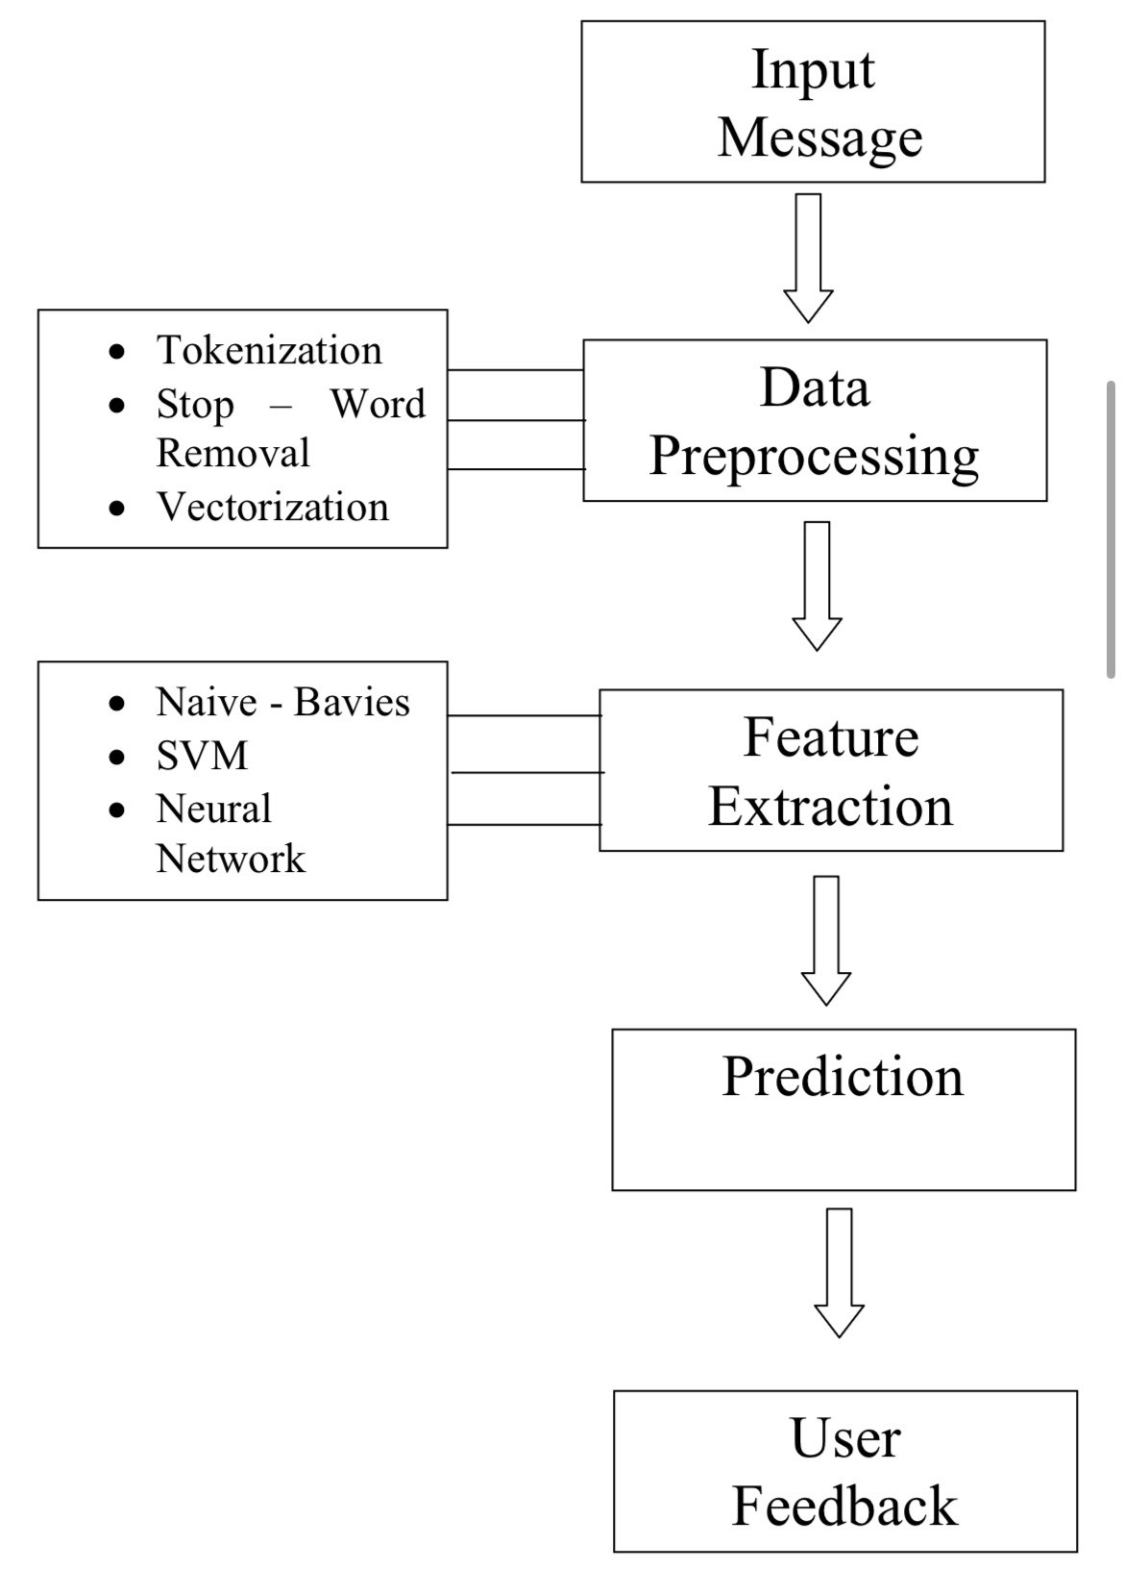
6. Theoretical Analysis
6.1 Architecture

Slide 9
6. Theoretical Analysis
6.2 Hardware Requirements
Processor: Intel i5 / AMD Ryzen 5 or higher (Recommended for AI model processing).
RAM: 8 GB minimum (Recommended: 16 GB for smoother AI inference and multitasking).
Storage: 20 GB free space (for application data, logs, and model files).
System Type: Desktop/Laptop with a stable broadband internet connection.
Cloud Infrastructure (AWS): Used for hosting the platform, database, and AI services.

Slide 10
6.3 Software Requirements
Frontend: React.js.
Backend: Spring Boot.
Database: MongoDB
- Programming Languages: Java, Python, JavaScript.
- AI/NLP: BERT, RoBERTa, Scikit-Learn, TensorFlow
- Authentication: JWT, OAuth2 for secure access.
- Notifications: Firebase and Twilio for real-time alerts.
Containerization and Deployment: Docker, Kubernetes.
Cloud: AWS for hosting and scalability.
Tools: Postman, VS Code, or IntelliJ IDEA.

Slide 11
Applications
Educational Institutions – Schools, universities, and colleges providing 24/7 mental health support to students.
Student Wellness Programs – Continuous mood tracking and wellness reporting for student support cells.
Online Counseling Platforms – AI-based emotion detection paired with professional counselor recommendations.
Mental Health Monitoring Systems – Early identification of emotional distress and crisis escalation.
Community Wellness Networks – Peer support forums and gamified engagement for healthcare support ecosystems.

Slide 12
GitHub Link
(https://github.com/piyush-ghoshi/Mindful)

Slide 13
REFERENCES
1. Devlin, J., Chang, M.-W., Lee, K., & Toutanova, K. (2019). BERT: Pre-training of Deep Bidirectional Transformers for Language Understanding. NAACL-HLT.
Liu, Y., Ott, M., Goyal, N., & Stoyanov, V. (2019). RoBERTa: A Robustly Optimized BERT Pretraining Approach. arXiv preprint arXiv:1907.11692.
Calvo, R.A., Milne, D.N., Hussain, M.S., & Christensen, H. (2017). Natural Language Processing in Mental Health Applications Using Non-Clinical Texts. Natural Language Engineering, 23(5), 649-685.
Fitzpatrick, K.K., Darcy, A., & Vierhile, M. (2017). Delivering CBT to Young Adults With Depression and Anxiety Using a Fully Automated Conversational Agent (Woebot). JMIR Mental Health.
Graham, S., Depp, C., Lee, E.E., et al. (2019). Artificial Intelligence for Mental Health and Mental Illnesses: An Overview. Current Psychiatry Reports, 21(11), 116.

Slide 14
THANK YOU!!
ANY QUERIES?

